Slide 1

Bankruptcy by COVID-19: Top Five Airlines Affected
By: Michael Teixeira

Slide 2











Target Audience:
Public Health Officials, Governing Officials,
Airline Companies,
Airports,
Travel Agencies,
Travelers
Introduction


1

2
3

4
Problem Statement.
Which airline is more likely to file for bankruptcy from COVID-19?
Answering the Problem Statement.
Creating an SIR model that simulates the interaction between five foreign countries and the United States
Our Metric.
The number of flights per day over the course of six months
Countries and AIrlines Involved.
EG
QA
NZ
SG
Qatar Airways
Turkish Airlines
Air New Zealand
Singapore Airlines
Emirates Airlines
SP

Slide 3


Average Price Per Trip
Methodology
Primary Focus:
Tracking airplane gas expense
Profit gained from ticket sales
Gasoline
International Ticket
Per Hour Flying
$4,000.00-$14,000.00
$356.51
$2,550.00

Slide 4
Data Sources
Beta/Gamma
Variables/Data Used
Assumptions
WHO
BusinessInsider
Bts.gov
Worldometers
Mckinsey
HowStuffWorks
Icao.int
Beta - Contact Rate
1/7 infected every 7 days
Gamma - Recovery Rate
1/14 recovered every 2 weeks
Ticket Price
Seat Capacity
Total Income
Fuel Cost
Foreign Population
US Population
Non-Parallel flights
Same Beta/Gamma
Random number of people boarded the airplane
No passenger recovered on a flight
At least one infected individual per flight
One hour flight travel
Airline reached zero flights, could no longer fly again
Methodology

Slide 5


Methodology - Simulation Overview
1
Setup our system with each countries airline and population data beginning on March 8th, 2020
The run simulation function simulates the pandemic for 6 months while calling our update function. This then updates the airline, foreign country, and United States
2
Country Population:
: 328.2 million - 541 Infected
: 98.42 million - 1 Infected
: 46.94 million - 647 Infected
: 5.639 million - 150 Infected
: 4.886 million - 5 Infected
: 2.782 million - 15 Infected
The beta and gamma influence the total infected population, altering the number of passengers and flights
3
QT (QA)
254 Seats
TA (EG)
337 Seats
ANZ (NZ)
168 Seats
SA (SG)
285 Seats
EA (SP)
517 Seats

Slide 6
Methodology - Flight Simulation
4
Simulate 60 flights per day. Based on the percent infected from both countries, a random amount of seats get filled on the airplane
Percent of infected individuals on the flight is determined by the total percent infected from both countries
5
Predictions:
Emirates will go bankrupt
Emirates will be the first to stop flying
The susceptible and infected population contribute to the destination country’s population.
6
Total Infected Percent = US Infected + Foreign Country Infected
Total Infected = Flights
Total Infected = Chance of Infected Passengers

Slide 7
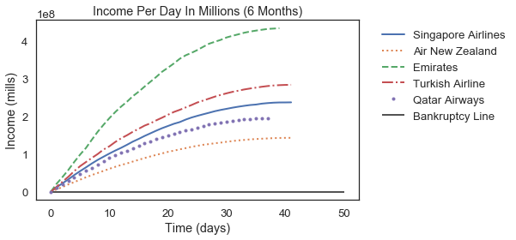
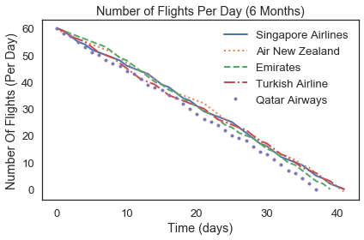
Results
Figure (1):
No airline had gone bankruptcy for as long as there were available flights.
Spain had made the most income
Figure (2):
As the number of infected individuals increased, the number of flights decreased
Qatar Airlines was the first airline to terminate operations
Figure (1)
Figure (2)

Slide 8
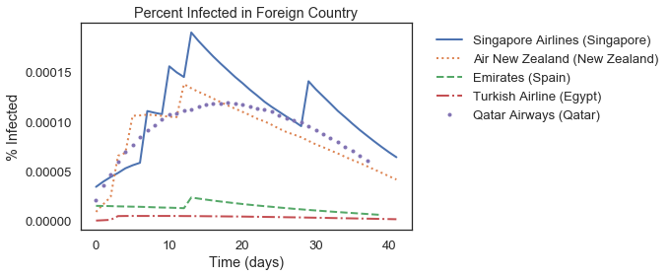
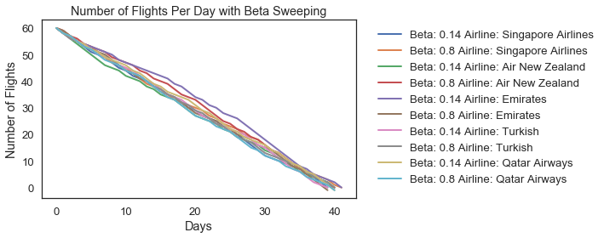
Results
Figure (3):
Spike increases are additional infected individuals added to a country
Countries with largest population had the smallest marginal affected
Figure (4):
Changing the beta values did not produce a significant difference
Air New Zealand was the first airline to terminate operations
Figure (3)
Figure (4)

Slide 9
Analysis
Large population does not always equate to an airline stopping operations first
Difficult to produce the same outcome because the model is highly dependent on probability and randomness
Limitations
Improvements

Values Dependent on Probability:
Number of airplane seats taken
Number of passengers
Number of infected passengers
Insufficient Data:
Relies only on income from ticket sales
Only expense tracked is gasoline
Neglects countries containing the same airline
Lacking sweeping data
Precise Beta and Gamma values for COVID-19
Sources and Computation:
Accurate Beta and Gamma values for COVID-19
Updated susceptibility and infected population
Average number of passengers on board
Larger variety of expenses
Computers with faster processing speed

Slide 10
Analysis
Accuracy
Precision and Robustness
Fruitfulness
Generality
We believe our model to not be entirely accurate .
Relies on too much probability
Random amount of passengers
Assumed beta and gamma values
Various quantities of airline seats
We believe our model to not be entirely precise and robust.
Too many assumptions
Inconsistent results
We believe our model to be fruitful.
Assumptions made are relevant
Justifiable probabilities
Legible results
We believe our model to not be entirely general.
Versatile with many countries
Versatile with many airlines

Slide 11
Conclusion
Real-life Applications
Government officials can apply quicker temporary regulations as to whether or not airline activity should be increased or decreased
Airline companies will lose money regardless and should come up with a travel package plan to mitigate the money lost
Future Research
More research is needed to find legitimate COVID-19 beta and gamma values to understand the true impact the virus had on each foreign country and the United States
Various airline expenditures should be included to find a true net income value for airlines
Takeaways
Airline companies situated in countries with lower populations should be prepared to close down operations sooner than countries with higher populations
Maintaining an airline is very expensive. Selling tickets alone is not enough to keep an airline company from going bankrupt.
Take Away

